Slide 1
Region 2
Rotary Club of Simi Sunset
“Shoes for Little Souls”
Kohl’s Department Store, Simi Valley
District Grant

Slide 2
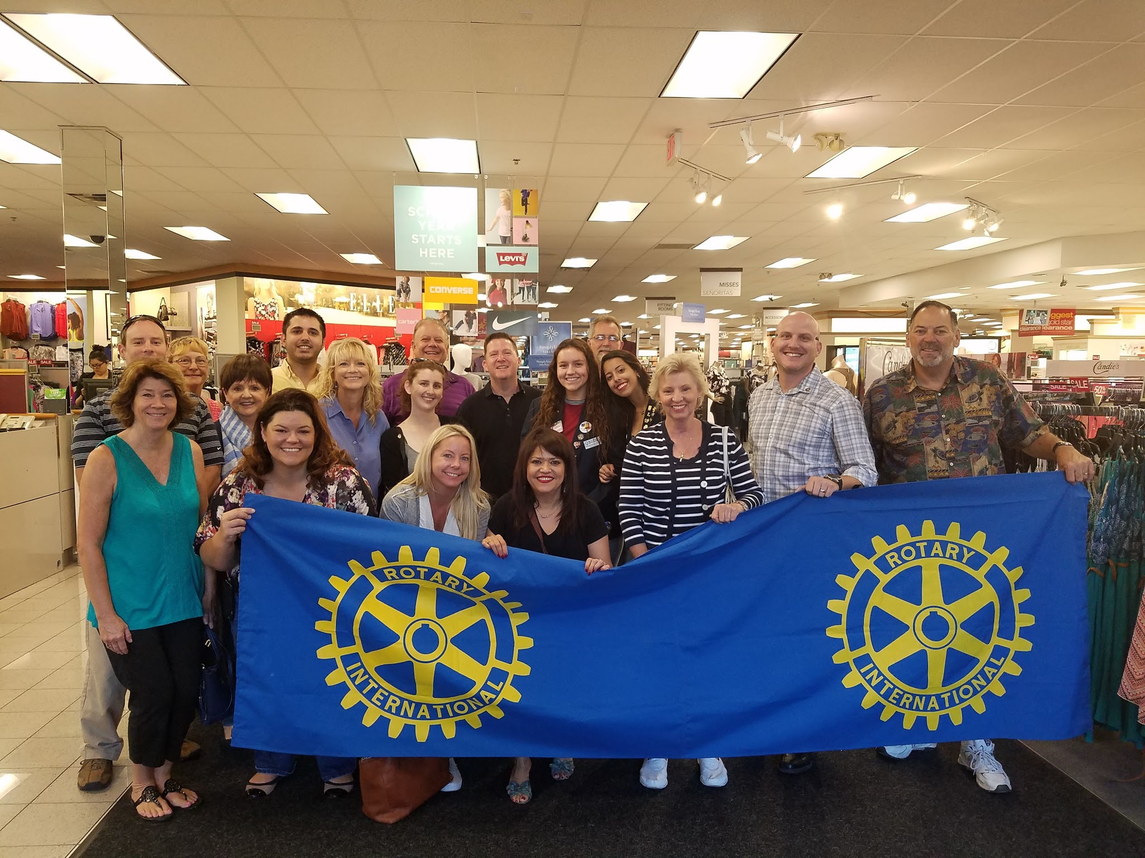
Every year, we provide a shopping spree for underprivileged children at Kohl’s Department Store in Simi Valley. The children are selected by the local Samaritan Center. This year we helped 18 children shop for new clothes and school supplies.

Slide 3
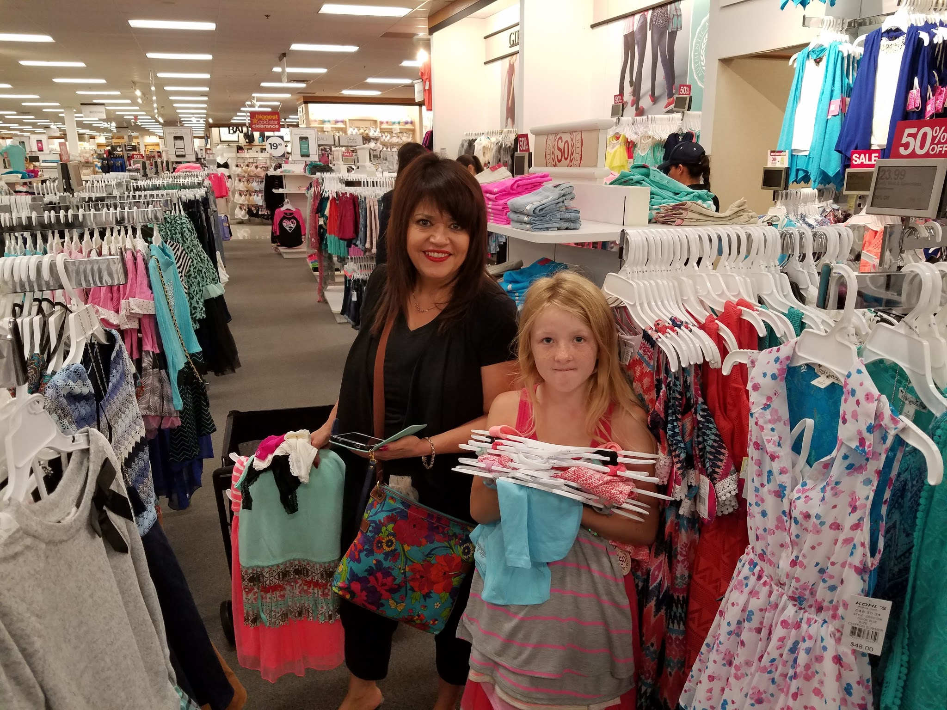
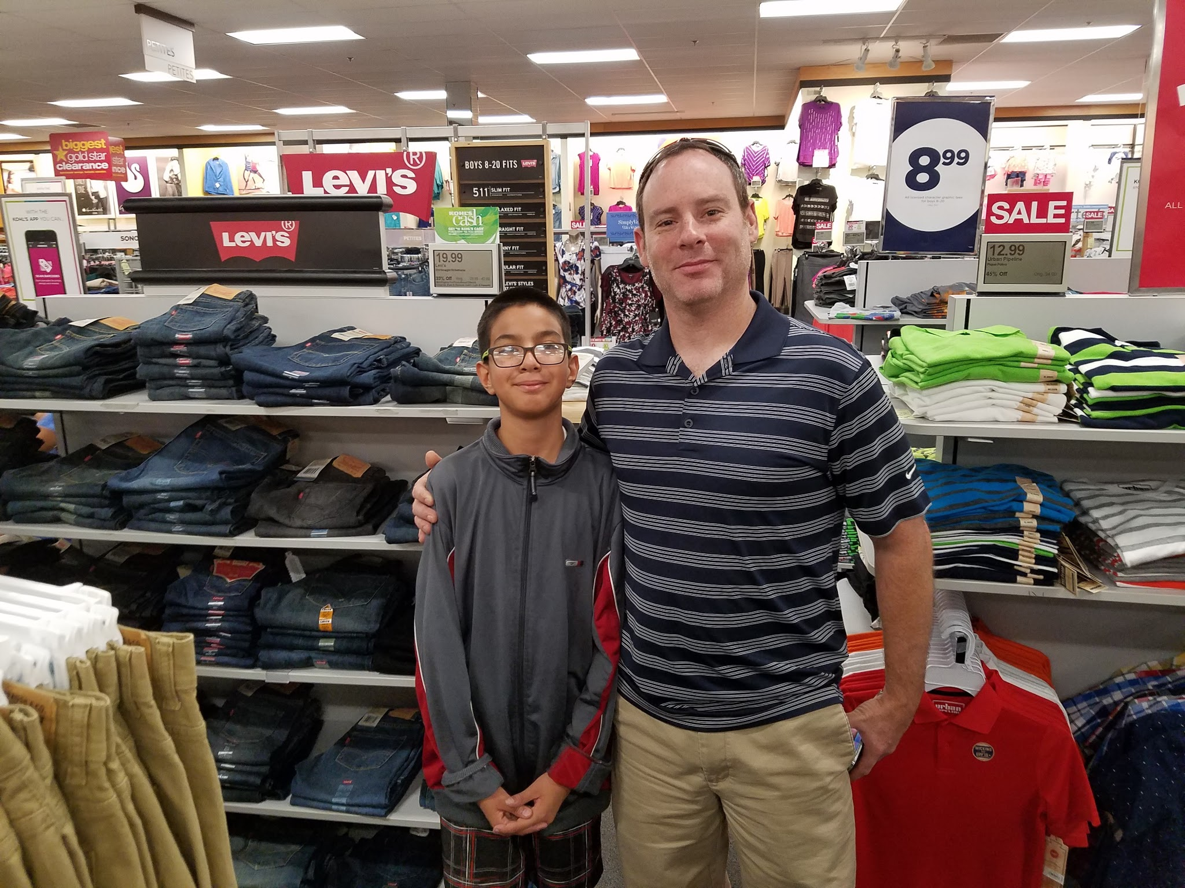
With the help of our District Grant and a great discount from Kohl’s Department store, we were able to provide each child with $235 worth of merchandise.

Slide 4
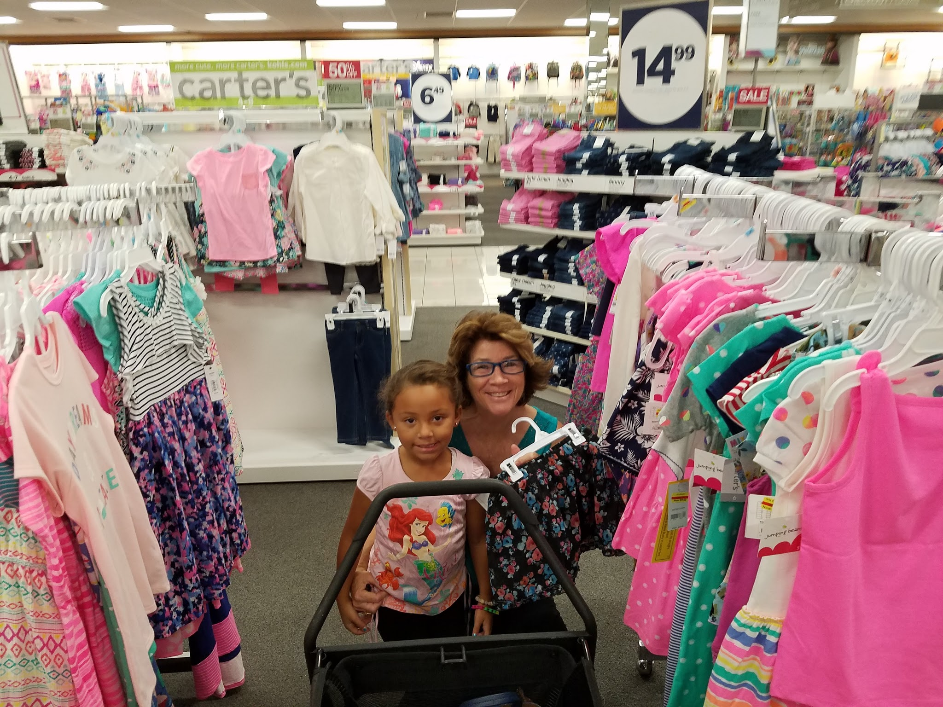
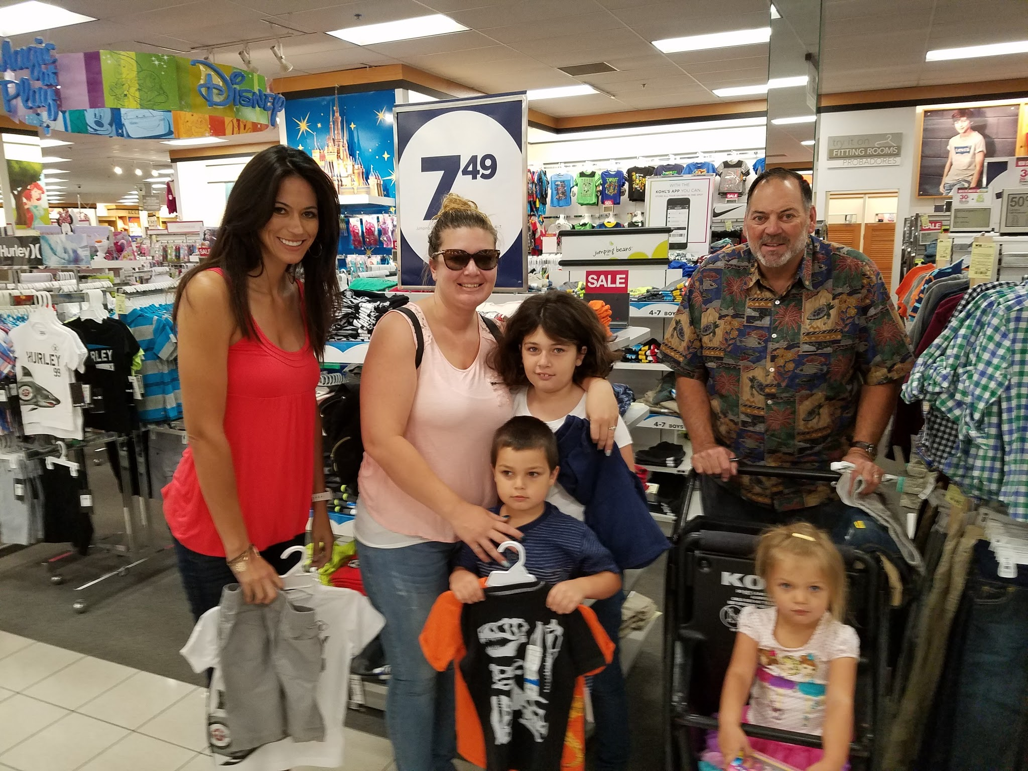
Rotarians helped the families shop. It was touching to watch the children’s faces light up while they browsed.

Slide 5
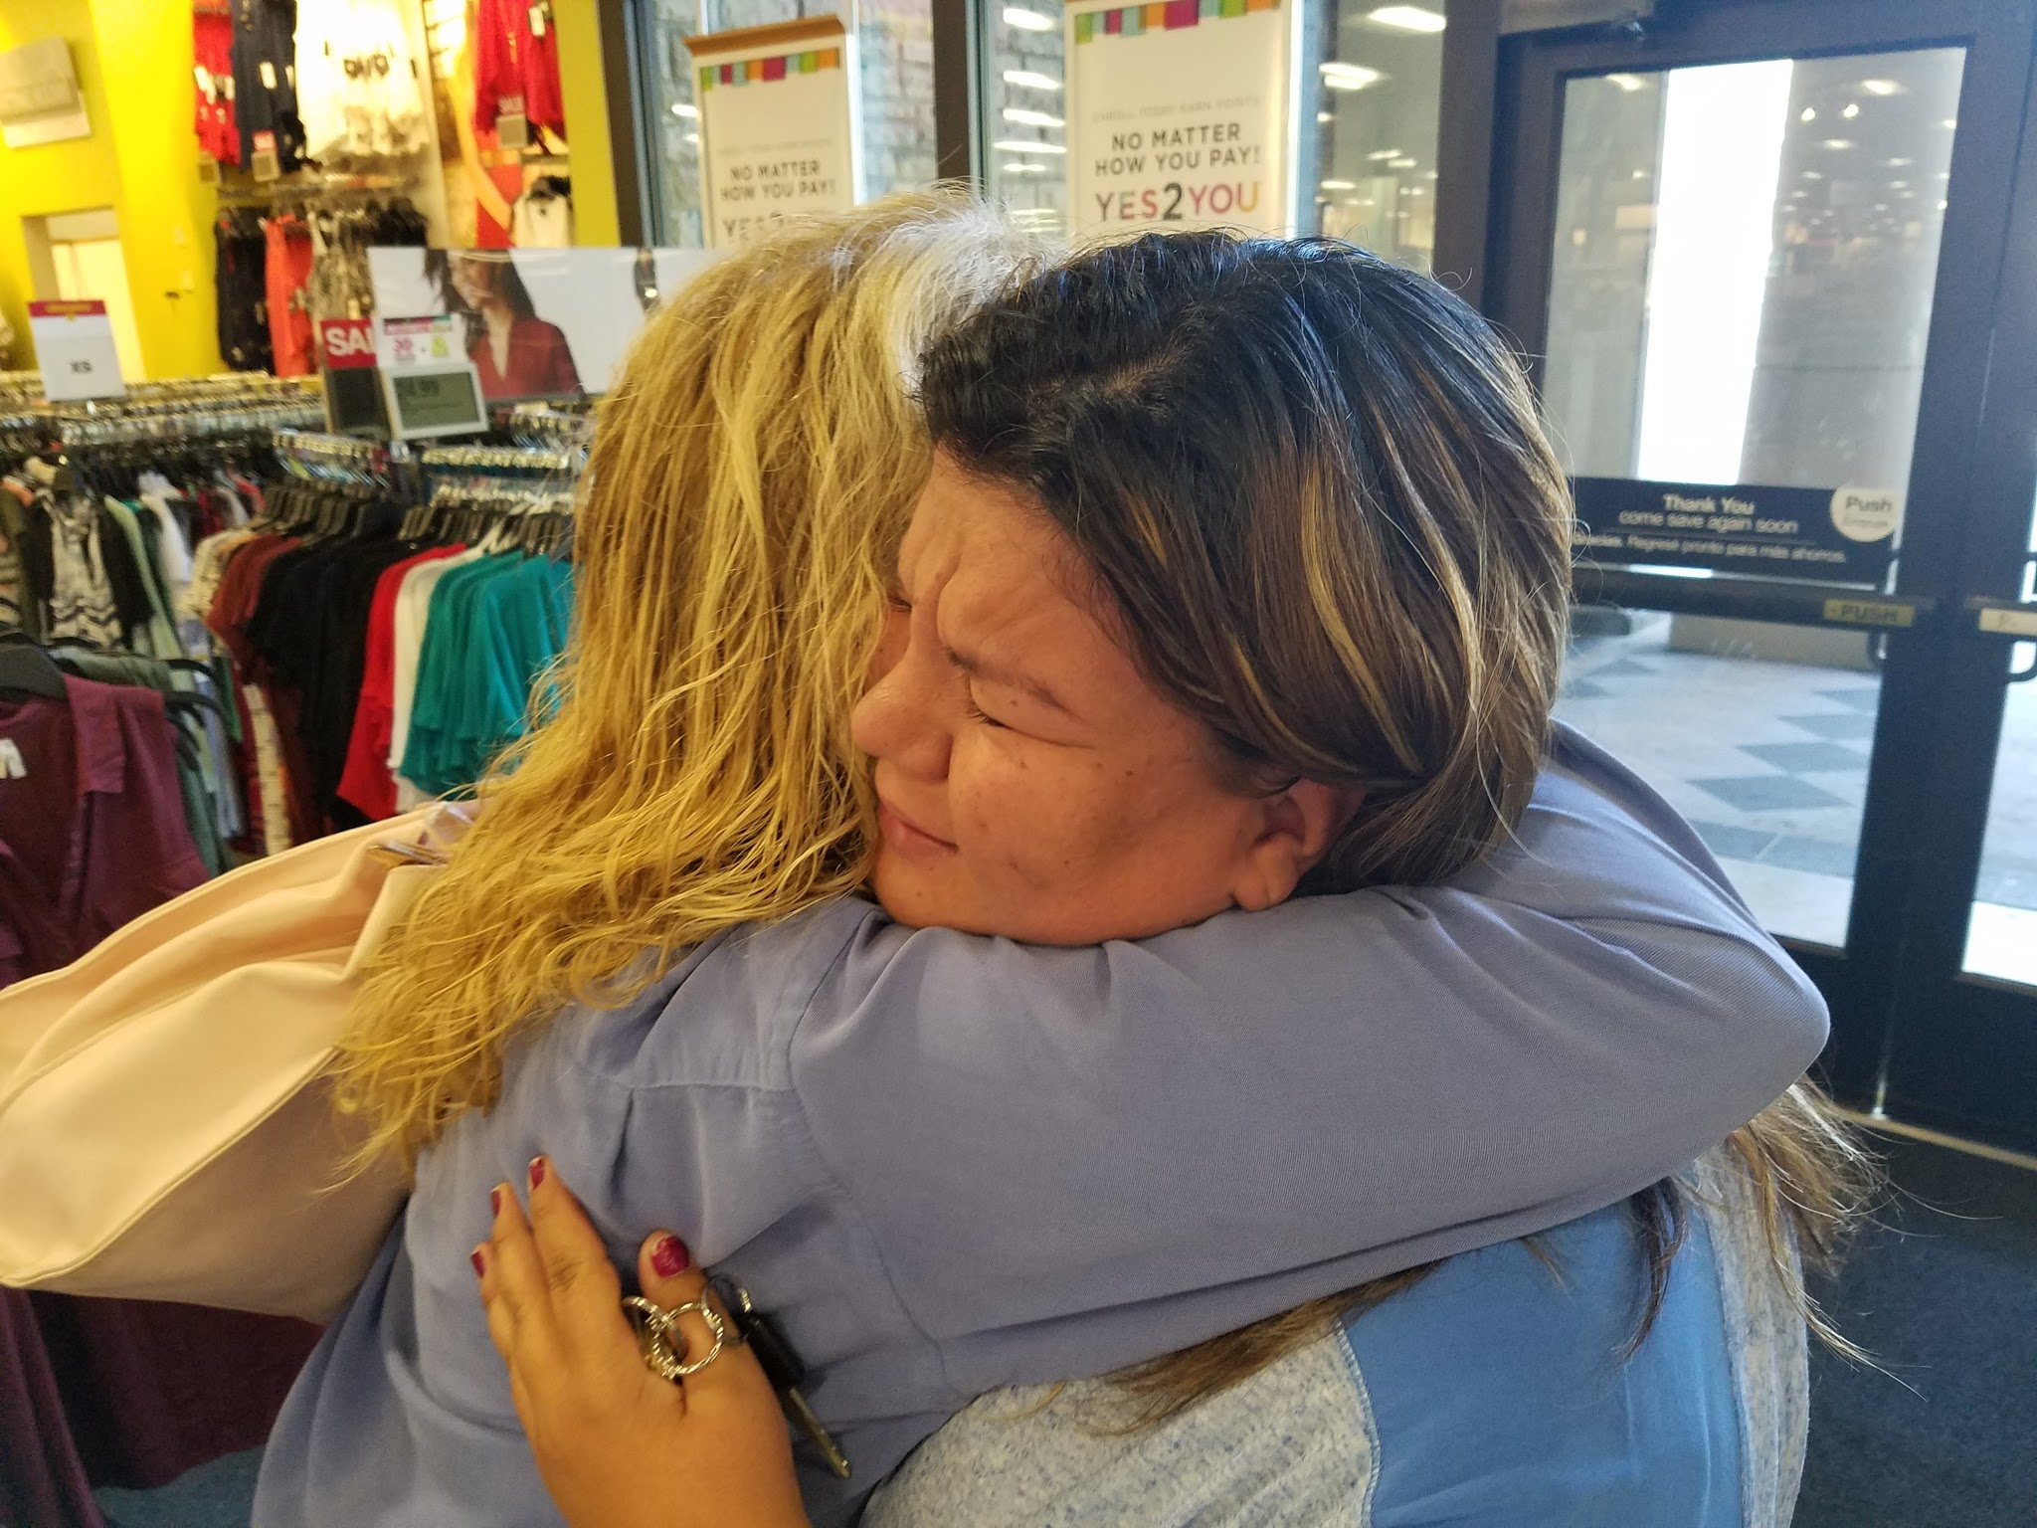
A mother was brought to tears for the amount of clothing and supplies Simi Sunset was able to provide for her family.

Slide 6
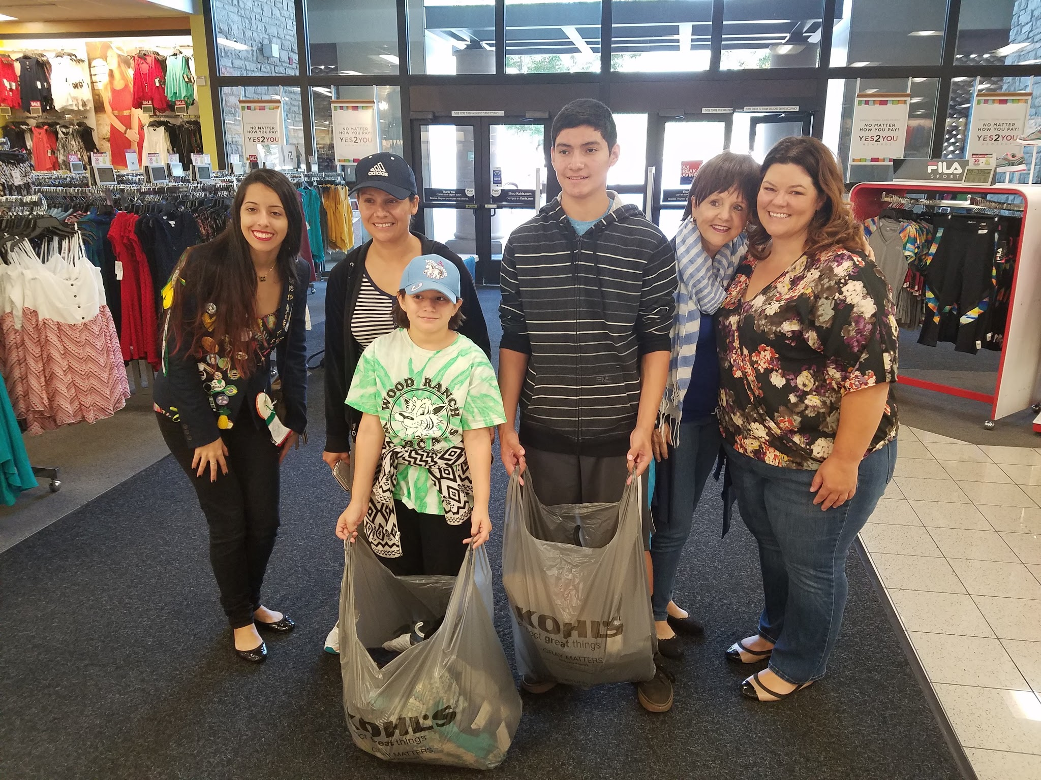
It was a good day for all involved. Children left with smiles on their faces, parents left with warmth in their hearts, and Rotarians left with their heads held high.

