Slide 1
Promoting Peacebuilding
&
Conflict Prevention
Notes:
Thank you for the invitation to spend some time with you speaking about peacebuilding. As we will learn, Rotarians have always been peacebuilders. So, before we go forward, it makes sense to define what we mean by peacebuilding.
The dictionary tell us that peacebuilding the implementation of measures intended to create or sustain peace, especially in an area affected by conflict. That isn’t completely helpful because now we have to define what we mean by peace. So we go back to the dictionary and find that peace is a a state of quiet or tranquillity; freedom from disturbance or agitation
A better definition might be Peacebuilding is a long-term process of encouraging people to talk, repairing relationships, and reforming institutions. It is an activity that aims to resolve injustice in nonviolent ways and to transform the cultural and structural conditions that generate deadly or destructive conflict. It revolves around developing constructive personal, group, and political relationships across ethnic, religious, class, national, and racial boundaries.
Having said all that, let’s take a look at our role as Rotarians in building peace.

Slide 2
THE ROTARY MISSION STATEMENT
We provide service to others,
promote integrity, and advance world understanding, goodwill, and peace through our fellowship of business, professional, and community leaders.
Notes:
The most important fact is that peacebuilding is not something new to Rotary or to Rotarians. We have always been peacebuilders. The Rotary Mission Statement simply confirms our commitment to world understanding, goodwill and peace.

Slide 3
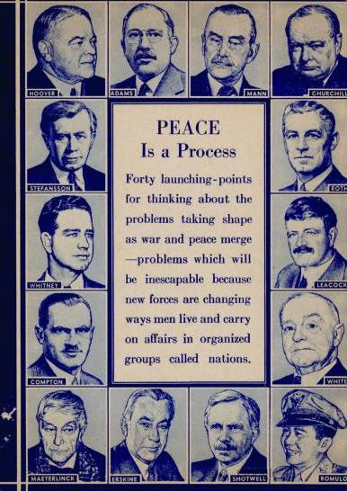
IN THE BEGINNING
1914: RI Convention adopts resolution “ to aid in the advancement of international peace and goodwill through friendship of business and professional men of all nations.”
1917: The Rotary Foundation created on the guiding principle to “bring peace to the world through education and relief of suffering, and by helping people better understand one another.”
Notes:
During World War I, Rotary on multiple occasions renewed its commitment to peacebuilding through friendship, education, relief of suffering and creating the opportunity for better understanding of others.
In 1917. The Rotary Foundation was founded by Arch Klumph on the principle that it will support RotarY’S commitment to bring peace to our world.

Slide 4
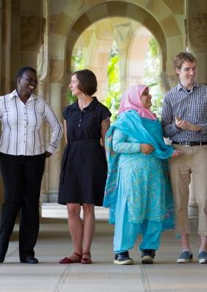
ROTARIANS HAVE ALWAYS
BEEN PEACBUILDER
1945: Rotary pivotal in the founding of the United Nations
1960: TRF focus on improving cross-cultural understanding
1988: RI President convened the first Rotary Peace Forum
2002: Rotary International Peace Centers established
2010: Peacebuilding and Conflict Prevention Area of Focus
Notes:
The commitment to peacebuilding continued after World War I.
In 1945, Rotary was one of two nongovernmental organizations invited to participate in the founding of the United Nations. Today, Rotary maintains an office at the United Nations and works closely with many UN organizations. UNICEF, for example, is one of six partners that make up the Global Polio Eradication Initiative.
The Rotary Peace Centers were established in 2002 and have trained hundreds of people in peacebuilding activities.
In 2010 the Rotary Foundation included Peacebuilding and Conflict Prevention as an area of focus for Rotary projects around the world

Slide 5

DISTRICT 5240 – A PEACEBUILDER DISTRICT
Donate $25,000 DDF Annually to Support the Rotary Peace Centers
Engage Rotary Clubs to Invest in Building Peace
Notes:
In Rotary Year 2015-16, under the leadership of Past District Governor Jim Bell, District 5240 became a Peacebuilder District. By committing to being a peacebuilder district, District 5240 supports the vital work in peacebuilding and conflict prevention that clubs and districts carry out through projects supported by
The Rotary Foundation. while also helping dedicated scholars become catalysts
for peace around the world.
Being a Peacebuilder district means that we donate $25,000 in District Designated Funds or cash to support the Rotary Peace Centers and that we encourage and support clubs in the district to invest in building peace.
A year later, with a great deal of support from, PDG Loretta Butts and District Peace Fellow Chair Michael Weaver, the District established the Peacebuilder Club Recognition Program to help clubs understand their role as peacebuilders in their own community and communities around the world.
The Peacebuilder Club Recognition program is continuing in our current Rotary Year under the leadership of DG Dana Moldovan and District Peace Chair Lee Carroll.

Slide 6
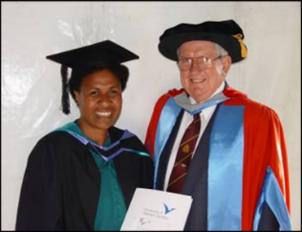
THE ROTARY PEACE CENTERS
Chulalongkorn University, Thailand (certificate program)
University of Bradford, England
International Christian University, Japan
Makerere University, Kampala Uganda
Duke University & University of North Carolina at Chapel Hill, USA
University of Queensland, Australia
Uppsala University, Sweden
Each year, Rotary selects up to 130 professionals from around the world to receive fellowships to study at one of seven Peace Centers
Notes:
Rotary established the Peace Fellow Scholarship program in 2002 stating, “Peacebuilding is a cornerstone of our mission as a humanitarian service organization.”
There currently seven Rotary Peace Centers – the most recent one having just opened in Kampala, Uganda. They are funded by donations to The Rotary Foundation that are designated for the peace centers.

Slide 7
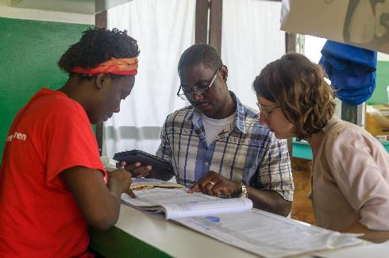
ROTARY PEACE FELLOWSHIPS
Master’s Program:
Young career professionals with at least a bachelors degree
Required 3 to 5 years of professional experience
Up to 50 fellowships awarded per year at one of 6 universities worldwide
Professional Development Program:
Experienced professionals in peace and conflict resolution
Minimum 5 years in experience in conflict resolution
Up to 80 fellows per year at one of 2 universities
Notes:
The Rotary Peace Fellowships provide the opportunity for qualified students to earn a Master’s degree or a certificate in Peacebuilding and conflict resolution.
Each year the Rotary Foundation selects up to 130 people to participate in the program.

Slide 8
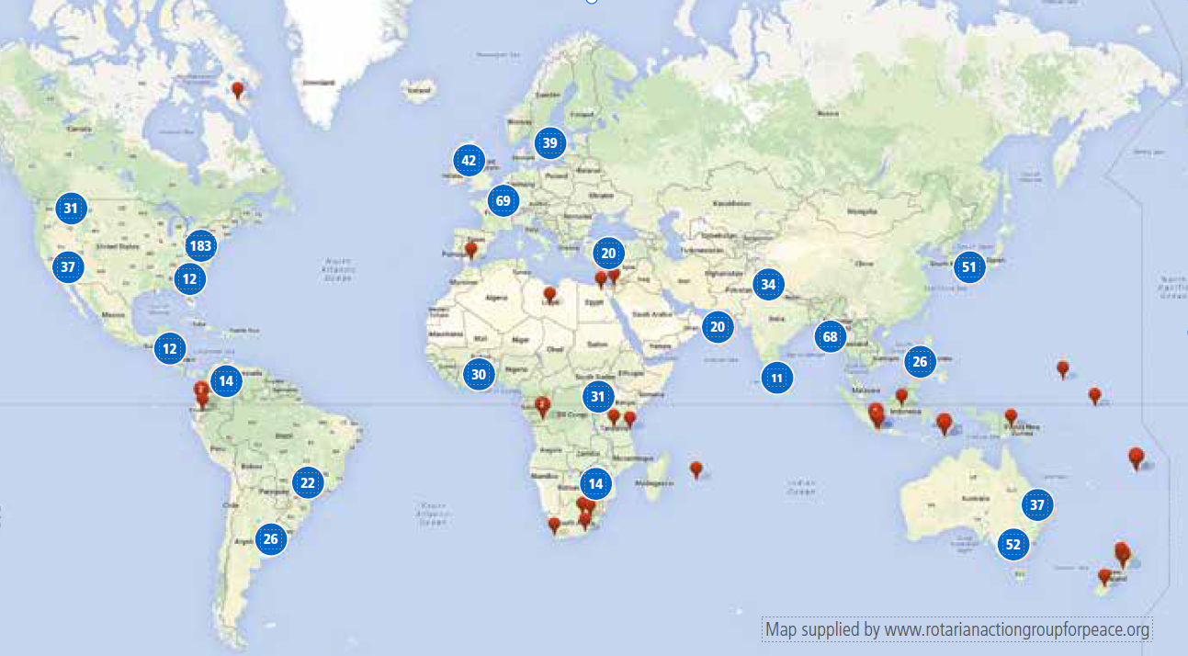
Peace Fellow Peace Map
Notes:
To date more than 1300 Peace Fellows have graduated from the program and gone out into the world to promote peace and conflict resolution and prevention.
Today hundreds of Rotary Foundation Peace Fellows are deployed around the world help to build peace.

Slide 9
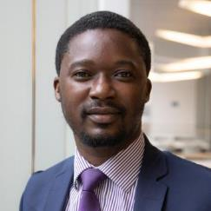
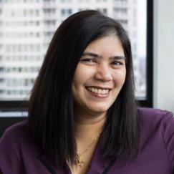
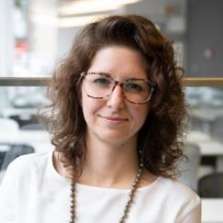
NOMINATE AND SUPPORT A PEACE FELLOW
Muyatwa Sitali, Programs and Outreach Officer, Sanitation and Water for All
ElsaMarie D’Silva, CEO,
Red Dot
Foundation
Hilary Caldis,
CEO,
The Female Voice
RECRUIT
Identify local professionals who are interested and qualified for advanced peace studies.
COACH
Evaluate whether a prospective applicant is a good fit and help each candidate make the best case.
NOMINATE
Help applicants navigate the process and understand how selections are made.
ENGAGE
Integrate peace center alumni with the Rotary community and maintain long-term ties.
Contact Peace Fellow Chair Michael Weaver (amweaver@pacbell.net)
Notes:
As a Rotarian in our district, you have the opportunity to nominate someone to be considered for a Rotary Peace Fellowship. They do not have to be affiliated with Rotary or even reside in our district
Two years ago, a candidate nominated by the Rotary Club of Thousand Oaks was selected to study at Bradford University as a Rotary Peace Fellow. This year our district nominated two candidates for Peace Fellowships to The Rotary Foundation
For more information contact Michael Weaver from the Rotary Club of Ojai who is our current district Peace Fellow Chair.

Slide 10
How Do You Measure Peace?
Notes:
If we want to talk about peacebuilding, it would be helpful have a way to measure how peaceful countries are? The Institute for Economics and Peace, a Rotary Partner, developed a Global Peace Index to measure how peaceful each of 163 countries in the world are today and then measure changes, both negative and positive, year to year.
The Global Peace Index measures that absence of direct violence and the absence of the fear of direct violence. Where does the US rank in the GPI? (answer (122)
Remember, we said that peacebuilding is more than removing violence.
The Positive Peace Index the presence of attitudes, institutions and structures that sustain peace. ( Where does the US rank – 31)

Slide 11
GLOBAL PEACE INDEX
The average level of global peacefulness deteriorated by 0.07 per cent in the 2021 Global Peace Index.
This is the ninth time in the last 13 years that global peacefulness has deteriorated.
The economic impact of violence to the global economy in 2020 was $14.96 trillion in purchasing power parity (PPP) terms. This figure is equivalent to 11.6 per cent of the world’s economic activity (gross world product) or $1,942 per person.
Notes:
Unfortunately, the Global Peace Index is moving in the wrong direction.
The economic impact of violence to the global economy last year is estimated to be $14.96 Trillion dollars. Imagine the impact if working together we could reduce that number by just 5% freeing 750 billion dollars to focus on positive peace.

Slide 12
What is Rotary International Doing?
We must concentrate not merely on the negative expulsion of war but on the positive affirmation of peace
Martin Luther King, Jr
Notes:
One of the most important aspects of Rotary and Peacebuilding is the recognition that achieving peace is more than avoiding war and civil strife. For peace to be sustainable, we have to change the environment and remove the conditions that are inhibitors to peace.

Slide 13
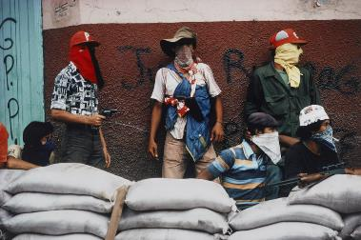
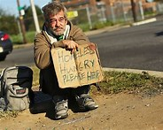
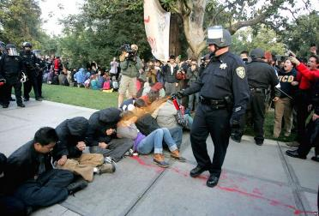
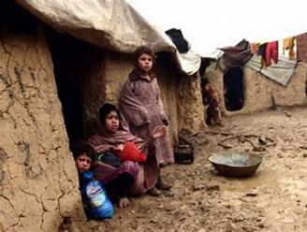
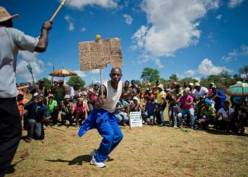
INHIBITORS TO PEACE
Internal Conflicts
Hopelessness
Injustice & Inequality
Extreme Poverty
Lack of Human Rights
Notes:
What are the inhibitors to peace. Each of these elements focus on the lack of opportunity for people to reach their full potential.

Slide 14
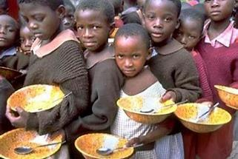
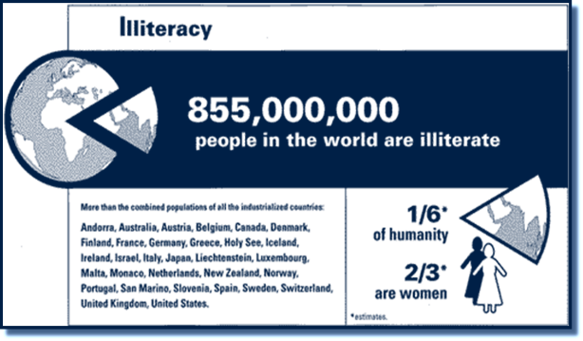
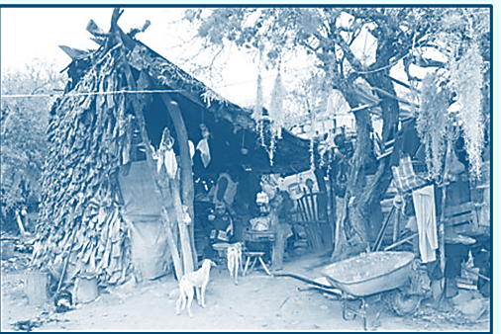

WHAT IN THE WORLD
14% of the World’s Population is Illiterate
820 Million People Do Not
Eat Enough to be Healthy
8.8% of the World’s Population Lives on Less Than $1.90/Day
Notes:
So where are we today::
820 million people do not have enough food to be healthy.
8.8% of the world’s population live on less than $1.90 per day – the level for ultra-poverty. The world bank tells us that as a result of the coronavirus pandemic, more than 100 million people will be forced back into poverty
14% of the world’s population is functionally illiterate.
Every minute of every day a woman or girl is trafficked or sold.
Not a pretty picture.

Slide 15
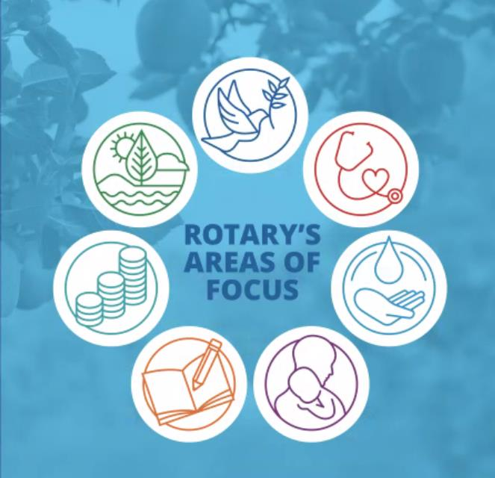


PILLARS OF POSITIVE PEACE
Well-functioning
government
Sound business
environment
Equitable
distribution
of resources
Acceptance of the
rights of others
Good relations
with neighbors
Free flow of
information
High levels of
human capital
Low levels
of corruption
Notes:
To eliminate the obstacles to peace, we need to focus on the concept of Positive Peace. To eliminate the obstacles to peace, we need to focus on the concept of Positive Peace which is defined as the attitudes, institutions, and structures that, when strengthened, lead to a more peaceful society. Positive Peace describes an optimum environment for human potential to flourish. The factors that sustain highly peaceful societies also provide a framework for robust economic development. Positive peace is based on eight pillars.
Positive peace is based on eight pillars. Projects that support the Rotary Foundations seven areas of focus support many of these pillars and help move communities in the direction of positive peace.

Slide 16

District 5240 Peacebuilder Clubs
Engage in Peace Literacy
Include Peace and Conflict Resolution in Project Community Assessments
Apply Peace Principles to Service Projects
  Eliminate Obstacles to Peace
  Connect with the Community
  Support Economic Opportunity
  Ensure Sustainability
Peacebuilder Club Status is Renewed Annually
Notes:
he Rotary Action Group for Peace and the leadership of District 5240 are encouraging clubs in our district to become PeaceBuilder Clubs as a way for local clubs to join in the effort to promote positive peace and resolve conflicts in their own communities and communities that they support around the world.
Peacebuilder Clubs
Engage in Peace Literacy –improving our own and our community’s ability to interact in a positive manner with everyone including those we disagree with.
Evaluate the impact on creating positive peace in their community projects and
Apply peace principles to their service projects and community activities.
In our district, your status as a peacebuilder club is renewed every rotary year.

Slide 17
PEACEBUILDER CLUBS ADDRESS HUMAN NEEDS
Food
Literacy
Water & Sanitation
Economic Opportunity
Shelter
Human Rights
Health Care
Conflict Resolution
HOPE
Notes:
To increase the index of positive peace, Peacebuilder clubs direct their projects to focus on human needs – those that address the physical needs of beneficiaries and those that address the ability of beneficiaries to thrive and grow

Slide 18
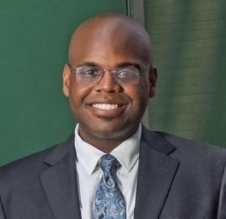
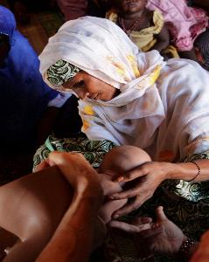
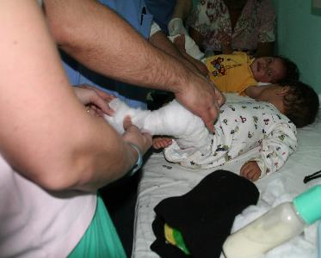
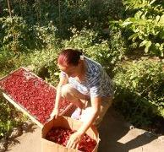
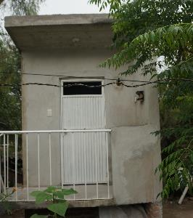
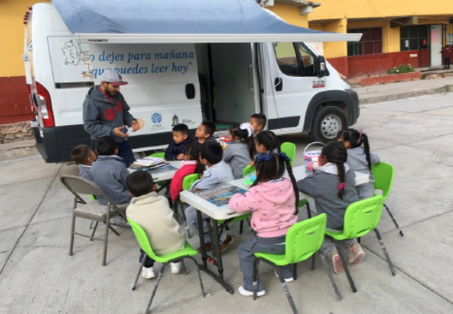
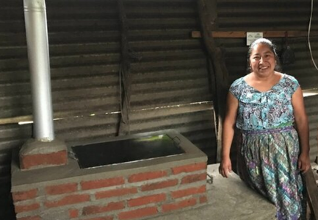
DISTRICT 5240 - GLOBAL POSITIVE PEACE
Promoting Peace
Saving mothers
& children
Fighting Disease
Growing Local Economies
Providing clean water, sanitation and hygiene
Supporting Education
Supporting the Environment
Notes:
Clubs in District 5240 have been involved in many international programs over the years that have improved the conditions for Positive Peace globally.
Top Left to Right
Terence Stevenson The most recent Peace Fellow sponsored by District 5240 – Thousand Oaks
Midwife Training in Niger - Ojai
Operation Footprint to correct Clubfoot Conditions Honduras Westlake Sunrise
Bottom left to right
Creating economic opportunity through growing and selling sundried tomatoes Bosnia Ojai
Water catch cisterns and eco-latrines Mexico – Simi Sunrise
Mobile Library Mexico – Cambria
Eco-stoves that vent smoke to the outside of the home and preserve forests by the ability to use other sources of fuel.

Slide 19
IN OUR OWN BACKYARD
The US is currently ranked 122 out of 163 countries
in the Global Peace Index
36.4 million Americans live below the poverty level
14% of adults living in America cannot read
“On a single night in January 2020,
580,466 people in the United States were homeless
Notes:
So – what’s happening in our own backyard.
The US is ranked 122 out of 163 countries on the Global Peace Index
36.4 million Americans live below the IRS poverty level – with more joining them as a result of the coronavirus pandemic
14% of adults in the US are functionally illiterate
Homelessness is growing

Slide 20


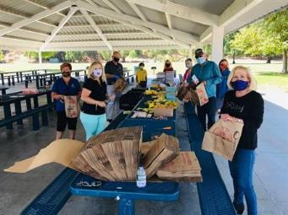
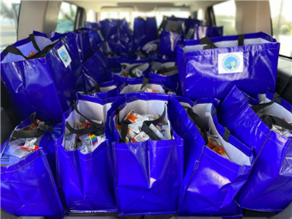
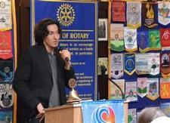
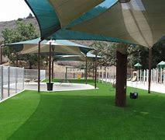
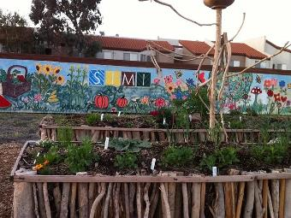
DISTRICT 5240 - LOCAL POSITIVE PEACE
Notes:
And in our local communities. Our Rotary Clubs have been at the forefront when our communities have faced disasters from fires, floods, disease and recessions.
Top left to right
Reyna Chavez – one of many local entrepreneurs helped by microfinance loans funded by a Rotary Foundation Grant
One of many local free clinics supported by Rotarians throughout the district
Rotarians pack food boxes for local food banks
Rotary clubs provide backpacks, school supplies and mentoring to local schools
Paul Chappell one of many programs that speak to Peace Literacy
Rotary Dreamcatcher Park – sponsored by Rotarians for people with special needs
Community gardens – supported by Rotarians throughout the district.

Slide 21
WHAT CAN ONE ROTARIAN DO?
Join the Rotary Action Group For Peace
Sign up for the Rotary Positive Peace Academy
Review your club’s current projects and talk about how your initiatives connect with the Pillars of Positive Peace
Look for new ways of investing in Positive Peace in your community
Sponsor a Positive Peace Workshop for young people to learn the skills to implement the Positive Peace framework
Sponsor a Rotary Peace Fellow application or fund workshops on Positive Peace for peace fellows
Notes:
So, the question is – I am only one person in one club what can I do.
Each Rotary member can become educated and involved in the Peacebuilding effort. Whether you want to participate locally or internationally. You can make a difference!

Slide 22
BECOME A PEACEBUILDER CLUB – STEP 1
Review the information on Peacebuilder Clubs on the
District 5240 Peace Page (www.rotarydistrict5240.org)
Create a Peacebulding Committee with a Chair and at least two members
who will participate in peacebuilding training
Notify the district
of the name of the Club Peacebuilder Chair
Email: peacebuilderclub@district5240.org
Update the Club Officer Information listed on the District Website
Notes:
The district created the peacebuilder club program to recognize your club for its peacebuilding activities.
We are currently updating the Peace Page on the district website. While we do, you can start by creating a peacebuilding committee with a chair and at least two members and letting the district know who is on your peacebuilding committee

Slide 23
BECOME A PEACEBUILDER CLUB – STEP 2
Present at least two Peacebuilder Education Programs
to your Club or Community
Plan and engage in at least two Peacebuilder
projects or activities during the Rotary year
Support the Rotary International Peace Centers
Notes:
You will find that becoming a PeaceBuilder club is both easy and rewarding. Your club is doing many things already that can qualify for peacebuilder club status

Slide 24
BECOME A PEACEBUILDER CLUB – STEP 3
Complete and Submit the Peacebuilder Club Report Form
Don’t Stop!! Continue to support Peacebuilding Activities throughout the Rotary Year
Notes:
By structuring and implementing your projects on the principles of positive peace, your community will see that your club is working to make positive changes that create a more peaceful community and world.
Don’t stop just because you qualified for a banner. Peacebuilding is an ongoing and continuing activity that can and should be part of everything you do.

Slide 25
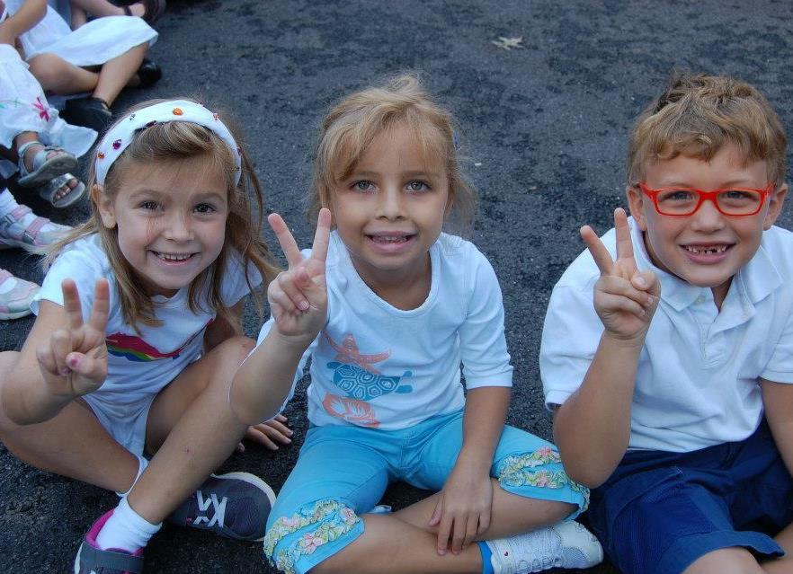
You are not Responsible for World Peace
BUT
You are Responsible for Your Piece of Peace
Notes:
You are not individually or as a club responsible for world peace. You are responsible for your piece of peace. One of the most important lessons I have learned from my Rotary experiences is that we truly change the world one life at a time. There are some projects that will require your entire club but for the most part, positive peace can be enhanced by you – one Rotarian – touching one life. The funny thing is that as your efforts help others to create a more peaceful society, the life that will be changed the most will be yours.

Slide 26
FOR MORE INFORMATION
Visit the District 5240 Website Peace Page
www.RotaryDistrict5240.org Select Club Resources Then Peace Page
Email: peacebuilderclub@district5240.org
Learn more about what Rotary is doing to build peace at
the website of the Rotary Action Group for Peace
https://rotaryactiongroupforpeace.org
Notes:
For more information, visit our District Peace Page, the website of the Rotary Action Group for Peace

Slide 27
Together, we see a world where people unite and take action to create lasting peace – across the globe, in our communities,
and in ourselves.
BUILD PEACE
Notes:
The Rotary Vision statement is to create lasting change – why not ensure that the change creates lasting peace.
What are you going to do to build peace.

